Slide 1
Objectives
In this session, you will learn to:
  Identify the hardware of a portable computer
Notes:
Students have learnt the structure of different types of dimensions and the importance of surrogate keys in Module I. In this session, students will learn to load the data into the dimension tables after the data has been transformed in the transformation phase. In addition, students will also learn to update data into these dimension tables.
Students already know about different types of dimension tables. Therefore, you can start the session by recapitulating the concepts. Initiate the class by asking the following questions:
1. What are the different types of dimensions?
2. Define flat dimension.
3. What are conformed dimension?
4. Define large dimension.
5. Define small dimension.
6. What is the importance of surrogate key in a dimension table?
Students will learn the loading and update strategies theoretically in this session. The demonstration to load and update the data in the dimension table will be covered in next session.

Slide 2

Introducing Hardware
What is a computer hardware?

Slide 3
Introducing Hardware (Contd.)
All physical and visible parts of a computer are known as the hardware of a computer.

Slide 4
Common I/O Devices
Mouse:
  Is an input device.
  Is used with graphical user interfaces.
  Is used to point and select various menus and options.
  May have one, two, or three buttons. The function of each button is determined by the interface.
  Is moved to make a parallel movement of pointer on the screen.
  Button is clicked to select the pointed option.
Notes:
Explain the benefits to the students with the help of the examples provided in the student’s guide.
Provide the following example to the students to understand the need for storing information in a consistent format:
Consider an example of a manufacturing enterprise where the enterprise obtains the Bill of Material (BOM) from various suppliers. All suppliers refer to the same material using different names and specifications. When a data warehouse is designed, an appropriate name and specification for the same product needs to be designed in a consistent format.

Slide 5
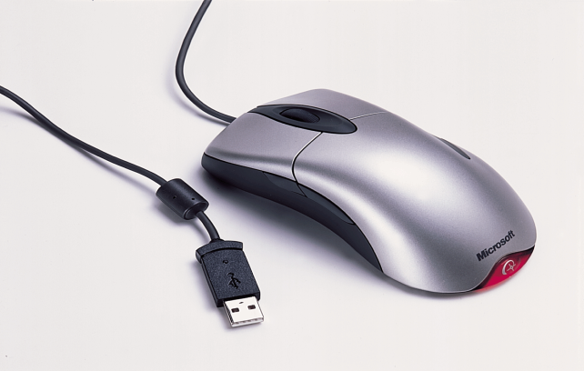
Common I/O Devices (Contd.)
Let us see a mouse.

Slide 6
Common I/O Devices (Contd.)
  A mouse can be categorized as:
  Mechanical
  Optical
  A mechanical mouse consists of a ball in its bottom surface. The ball rotates as the mouse moves along a flat surface.
  An optical mouse uses a light beam instead of a rotating ball. The light beam helps detect the mouse movement.
Notes:
Explain the benefits to the students with the help of the examples provided in the student’s guide.
Provide the following example to the students to understand the need for storing information in a consistent format:
Consider an example of a manufacturing enterprise where the enterprise obtains the Bill of Material (BOM) from various suppliers. All suppliers refer to the same material using different names and specifications. When a data warehouse is designed, an appropriate name and specification for the same product needs to be designed in a consistent format.

Slide 7
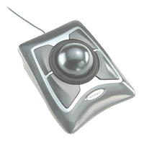
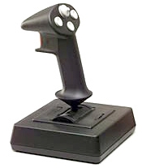
Common I/O Devices (Contd.)
  The different types of mouse are:
  Trackball mouse: The ball of the mouse is rolled with the thumb, fingers, and palms. The following figure shows a trackball mouse.
  Joysticks mouse: It includes two vertical sticks. The sticks is moved with the hands. The button on either stick is pressed to select any option. The following figure shows a joysticks mouse.

Slide 8
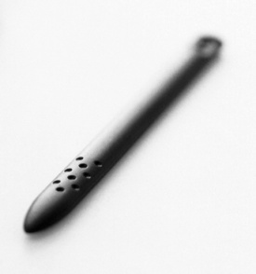
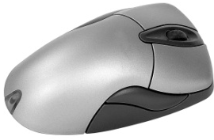
Common I/O Devices (Contd.)
  Light pen mouse: It uses a light-sensitive detector. A pen is used to point at the screen. The following figure shows a light pen mouse.
  Wireless mouse: It is a mouse without a cable. It can work from a distance of one and a half meters away from the computer. The following figure shows a wireless mouse.

Slide 9

Common I/O Devices (Contd.)
  Touch pad mouse: It is a small, flat, rectangular pointing device. It is sensitive to pressure and motion. The following figure shows a touch pad mouse.

Slide 10
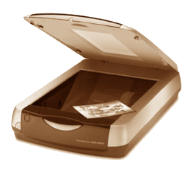
Common I/O Devices (Contd.)
Scanner:
  Scans an image.
  Transforms the image to ASCII code.
  The three types of scanner are:
  Flatbed scanner: It works like a copy machine. It creates a file rather than a paper copy. The following figure shows a flatbed scanner.

Slide 11
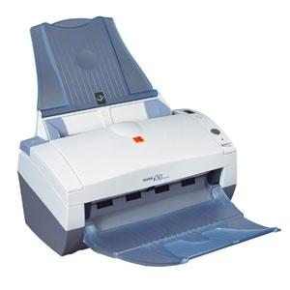

Common I/O Devices (Contd.)
  Sheetfed scanners: It is like a fax machine. It moves the page being scanned pass the scanning head. The following figure shows a sheetfed scanner.
  Handheld scanners: It builds a small handheld unit of the scanning element. The handheld unit is then rolled over the item being scanned. The following figure shows a handheld scanner.

Slide 12
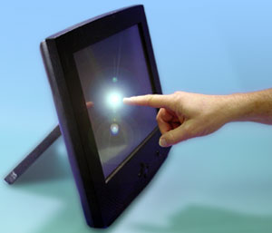
Common I/O Devices (Contd.)
Touch screen:
  Is used to access information with minimum effort. The following figure shows a touch screen.
  The four types of touch screens are:
  Resistive touch screens
  Infrared touch screens
  Surface acoustic touch screens
  Capacitive touch screens

Slide 13
Common I/O Devices (Contd.)
Printer:
  Is an output device.
  Prints the result of an operation on a paper.
  Can be classified on the following parameters:
    The mechanism used for printing
    The speed of printing
    The quality of output
    The direction of printing
    The kind of interface printers share with the computer
Notes:
Tell the students that dimensions are components of data mart/ data warehouse. Dimensions will be discussed in details in Ch5.

Slide 14
Common I/O Devices (Contd.)
  The two types of printers are:
  Impact printer: It prints the characters by pressing a typeface against an inked ribbon. The inked ribbon makes a mark on the paper. The most commonly used impact printer is Dot Matrix Printer (DMP).
  Non-impact printer: It is much quieter than the impact printers. Their printing heads do not hit the paper. There is no contact between the typeface and the paper while printing. The various types of non-impact printer are:
    Laser printers
    Inkjet printer
    Thermal printer

Slide 15
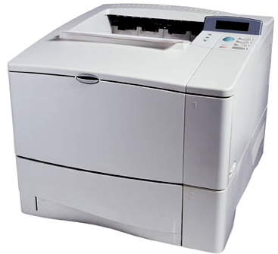
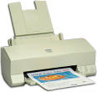
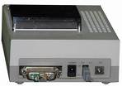
Common I/O Devices (Contd.)
  The following figures shows various types of non-impact printer.
Laser Printer
Inkjet Printer
Thermal Printer

Slide 16
Common I/O Devices (Contd.)
Plotter:
  Is an output device.
  Is used to create presentation visuals, charts, graphs, tables, and diagrams.
  Needs high-quality pens to draw clear and high-quality diagrams.
  Can be connected to a PC through the parallel port.
  Is used in applications like Computer Aided Design (CAD) that require high-quality graphics on paper.
Notes:
Tell the students that dimensions are components of data mart/ data warehouse. Dimensions will be discussed in details in Ch5.

Slide 17
Common I/O Devices (Contd.)
  The two types of plotters are:
  Flatbed plotters: In this, the paper is held still. The arm and the pen move over the paper.
  Drum plotters: In this, the paper is wrapped around a drum and attached at both ends. The drum rotates while the pen moves laterally along a fixed rail.
Notes:
Tell the students that dimensions are components of data mart/ data warehouse. Dimensions will be discussed in details in Ch5.

Slide 18
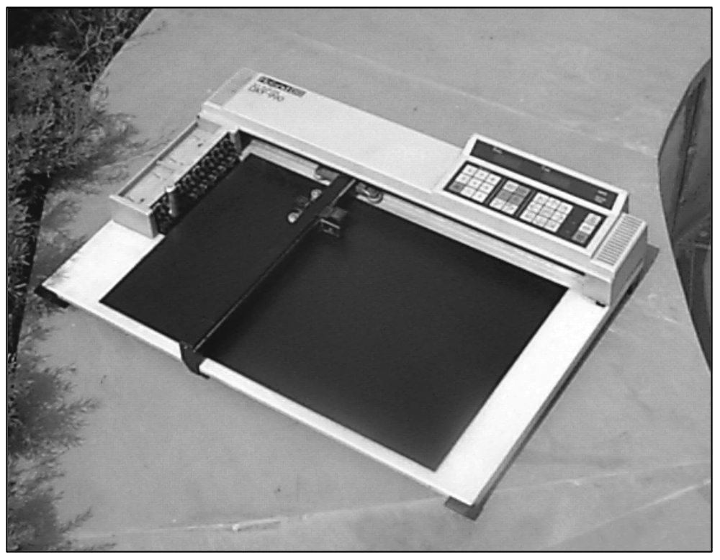
Common I/O Devices (Contd.)
  The following figure shows a flatbed plotter.
Pen Holder
Pen
Arm
Flatbed
Notes:
Explain the benefits to the students with the help of the examples provided in the student’s guide.
Provide the following example to the students to understand the need for storing information in a consistent format:
Consider an example of a manufacturing enterprise where the enterprise obtains the Bill of Material (BOM) from various suppliers. All suppliers refer to the same material using different names and specifications. When a data warehouse is designed, an appropriate name and specification for the same product needs to be designed in a consistent format.

Slide 19
Storage Media
How can we store our data for later use?

Slide 20
Storage Media (Contd.)
The data is stored on a storage media for its later use.
  The three types of storage media are:
  Cartridge tape
  Compact Disc-Read Only Memory (CD-ROM)
  Memory stick

Slide 21
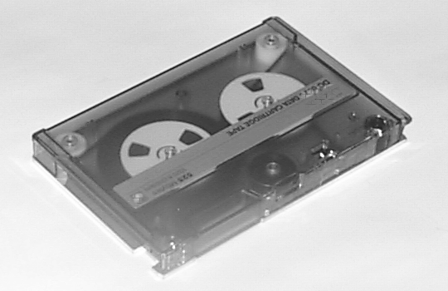
Storage Media (Contd.)
Cartridge tape:
  Is made up of plastic films and coated with magnetic material.
  Stores data sequentially.
  Is ideal as a backup medium.
  Is not recommended in cases where data is required at random and at high speeds.
  Requires a cartridge tape drive to read and write on the tape.
  The following figure shows a cartridge tape.

Slide 22
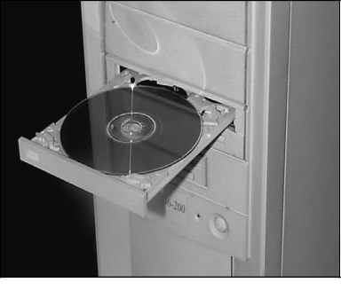
Storage Media (Contd.)
CD-ROM:
  Can store large amount of data (700 MB or more).
  Can be erased and written only with the help of a
  CD-Recorder.
  Requires a CD-ROM drive to read the data from it.
  The following figure shows a CD-ROM.
CD-ROM
CD-ROM
Drive

Slide 23
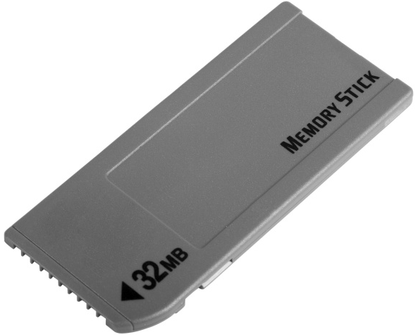
Storage Media (Contd.)
Memory stick:
  Is a standard digital data storage and transfer media.
  Is portable, light, reliable, and easy-to-use.
  The following figure shows a memory stick.

Slide 24
Summary
In this lesson, you learned that:
  Some input and output devices that you will find in a working environment are:
    Printers
    Scanners
    Plotters
    Touch screens
  The three types of storage media are:
    Cartridge tape
    CD-ROM
    Memory stick

